Slide 1
Change header style
Also. Same menu.
Full width
All Page

Slide 2
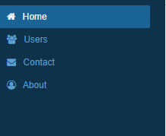
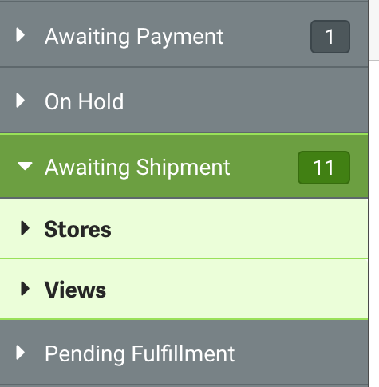
Same style
All Page

Slide 3
Same style
All Page

Slide 4
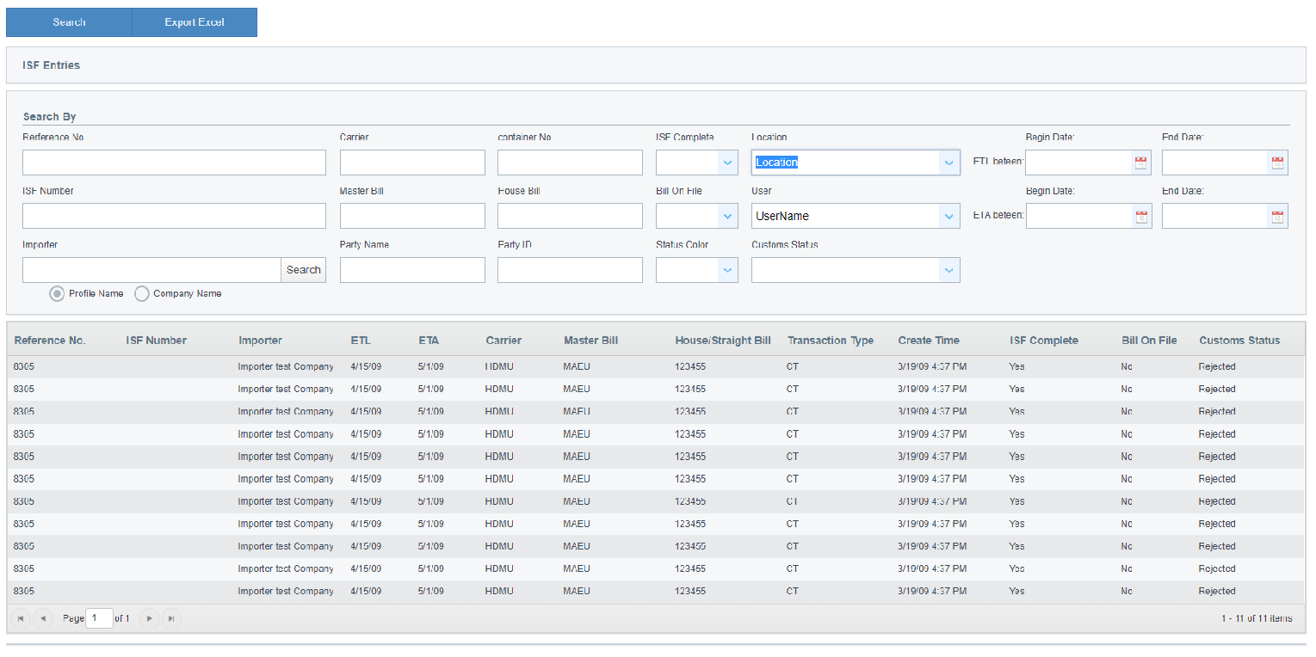
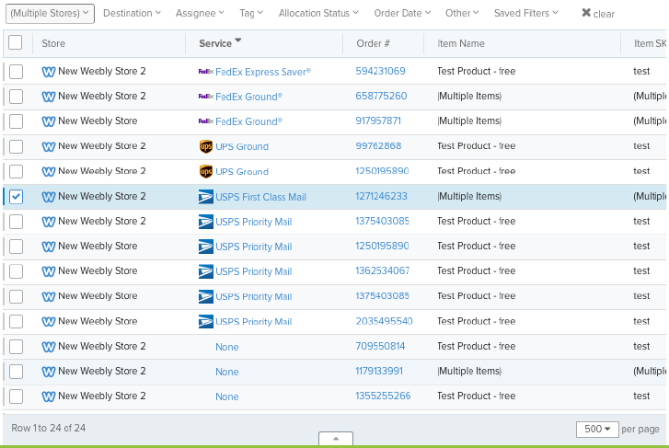
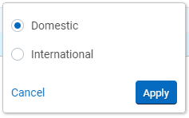
#3 Slide
Remove it
New Search layer
Change Grid header Color
reference #5 slide
When user click

Slide 5
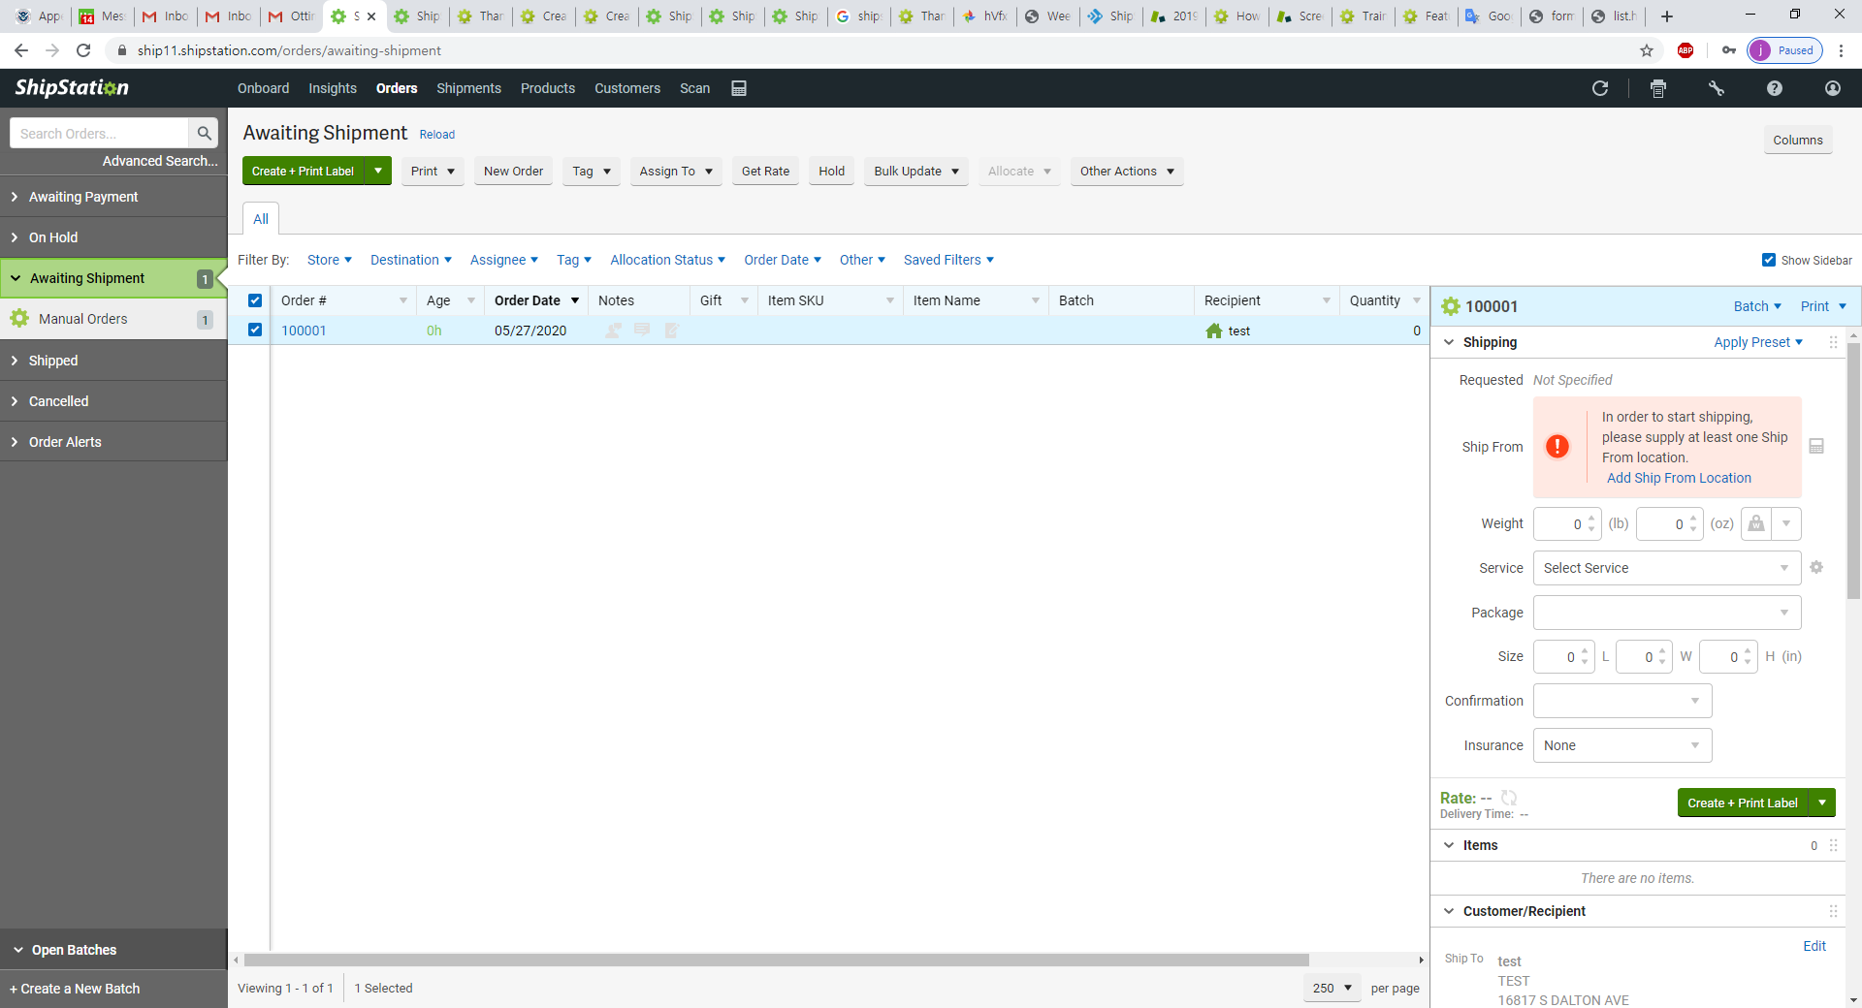
Sample screen
Bottom fit.

Slide 6
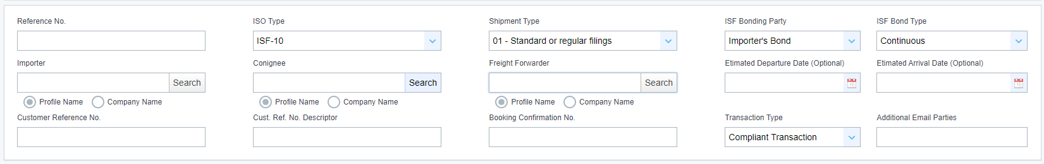
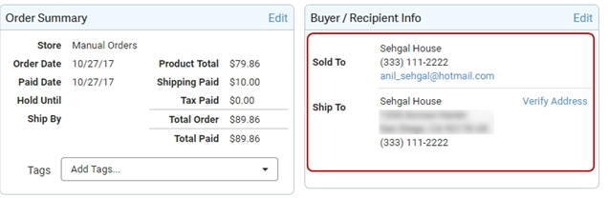
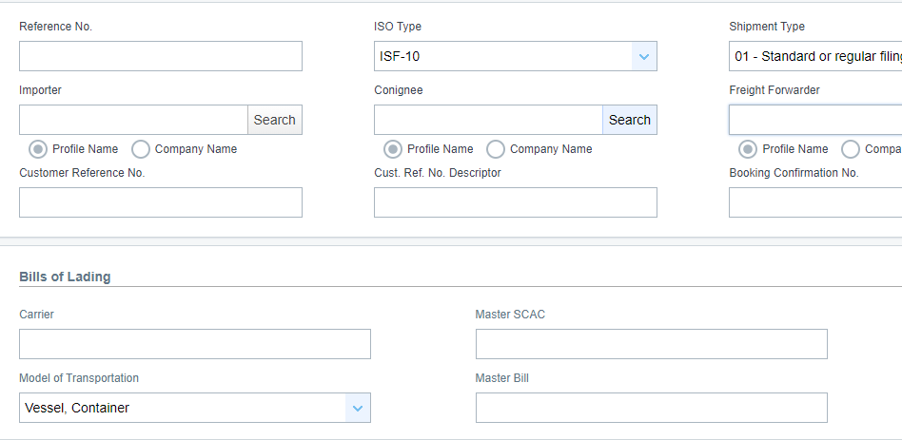
Remove
Change to. Header
Same header color

Slide 7
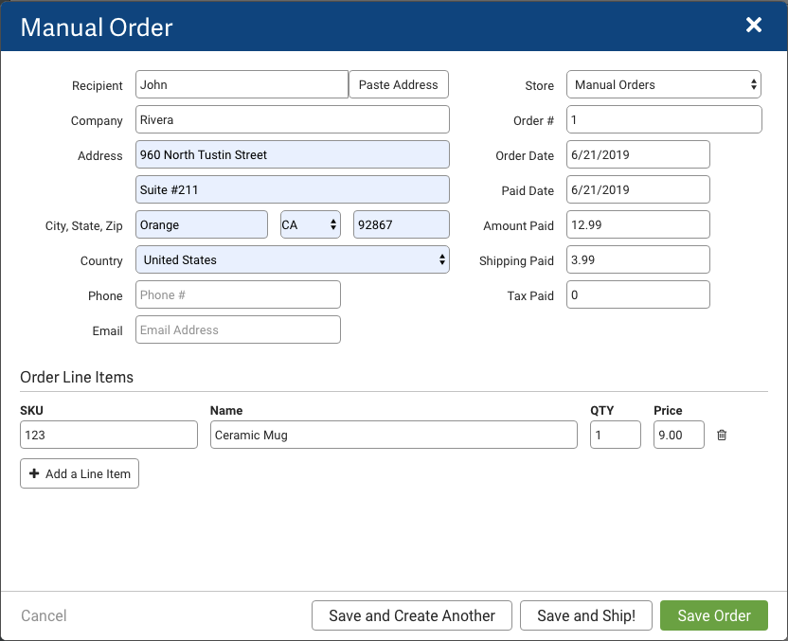
Location change
ISF Entry (Main)
Bill of Landing
Selling Party
Buying Party
Ship to Party
Consolidator
Stuffing Location
Menu bar
Manufacturer Grid only not form
Additional Entities Grid only not form
Menu bar
When click modal
Show form.
Modal style

Slide 8
